Slide 1


© 2014 Microsoft Corporation. All rights reserved. Microsoft, Windows, and other product names are or may be registered trademarks and/or trademarks in the U.S. and/or other countries.
The information herein is for informational purposes only and represents the current view of Microsoft Corporation as of the date of this presentation. Because Microsoft must respond to changing market conditions, it should not be interpreted to be a commitment on the part of Microsoft, and Microsoft cannot guarantee the accuracy of any information provided after the date of this presentation. MICROSOFT MAKES NO WARRANTIES, EXPRESS, IMPLIED OR STATUTORY, AS TO THE INFORMATION IN THIS PRESENTATION.

Slide 2

Microsoft
DevCamp
App packaging, monetization and publication

Slide 3
App packaging

Slide 4
Universal Windows apps are still appx packages…

Slide 5
Easy Deployment
Reliable and safe install
Hassle free updates
Manifest Declarations
Formal versioning
Clean uninstall
Device family targeting
Space Savings
Incremental updates
File single instancing
Declarative model
Partial resource downloads

Slide 6
Incremental updates

Slide 7
Windows Store backend
App update
Windows App V1.0
Shared file
Windows App V2.0
File 1
Download
File 1
File 1
1
3
5
1
3
5
1
3
5
2
4
6
2
4
6
2
4
6
File 2
File 2
File 2
1
3
5
1
3
3
5
1
5
Copy identical file blocks
2
2
4
2
4
6
4
6
6

Slide 8
Continued support
Previous app package format compat preserved
Appx continues to be path forward

Slide 9
File single instancing

Slide 10

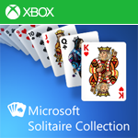
Windows app install
Windows app update
Shared files
Ad platform
Ad platform
File 5
File 6
Ad platform
File 1
File 2
File 5
File 6
File 3
Game engine
File 4
File 7
File 8
Game engine
Game engine
Game engine
File 7
File 8
Game engine

Slide 11
Partial resource downloads

Slide 12
Universal Windows app with scale resources
Scale-100
Scale-150
Scale-200
Scale-250
Scale-300

Slide 13
Storage Improvements

Slide 14
More Windows apps with less built-in storage

Slide 15
Storage Improvements
Install or move Windows apps to external media
App payload + application data encrypted on external media
Shared publisher application data

Slide 16
In summary…
Feature | XAP 8.1 | AppX 8.1 | AppX 8.1 | AppX 10.x
Platform | Windows Phone 8.1+ | Windows Phone 8.1+ | Windows 8.1+ | Windows 10+
Device OS Build version targeting | No | No | No | Yes
Encryption | Yes | No | No | No, not yet.
App Bundles | No | Yes | Yes | Yes
Debug Package Signing | No | No | Yes | Yes
Differential Download/Update | No | Yes | Yes | Yes
File Single Instancing | No | Yes | Yes | Yes
External Volume (SD) Installation | Yes, Phone 8.1+ | Yes, Phone 8.1+ | Yes, Windows 10+ | Yes
Shared publisher storage | No | No | No | Yes

Slide 17
Publishing

Slide 18

One Store for one Windows
Windows Desktop
Windows Mobile
ONE CORE OS
ONE APP PLATFORM
ONE STORE
Windows 10
Xbox
IoT
HoloLens
Surface Hub

Slide 19
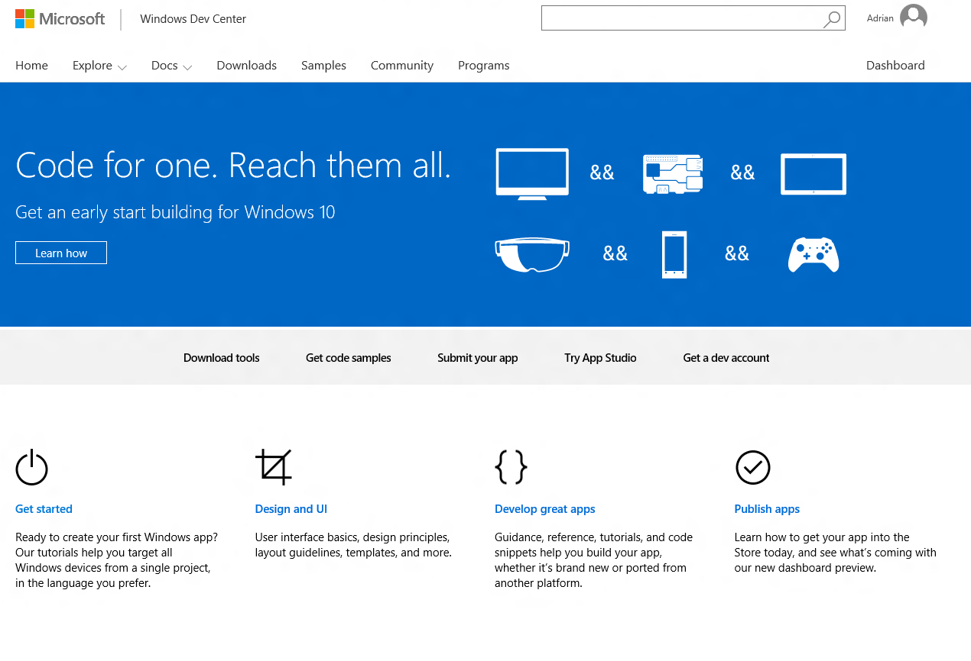
One Dev Center
One destination for supporting all Windows devices
One registration
One app submission
Customer acquisition
Customer engagement
Powerful monetization
Rich analytics
One payout
Preview available now!
DEV.WINDOWS.COM

Slide 20

One Store for all devices
Desktop Clients
Mobile Clients
ONE WINDOWS DEV CENTER
Xbox, HoloLens, Surface Hub
Web storefronts

Slide 21
One submission
All your apps managed from one dashboard
One submission for all of your packages and metadata, one certification
Aligned with how your customers already see your apps
Easy to add new packages for Windows 10 to your existing apps

Slide 22



Merging linked apps and IAP
Application
IAPs
Packages
.xap, .appx, .appxbundle
Pricing
Store listings
IAP 1
Pricing / Listing
IAP 2
Pricing / Listing
Application
IAPs
Application
IAP 3
Pricing / Listing
Packages
(7.1/8.0/8.1)
Pricing
Store listings
IAP 1
Packages
(8.0/8.1)
Pricing
Store
listings
IAP 2
IAP 2
IAP 3

Slide 23
Merging details
Windows Phone
Windows
Application
Base Price
Markets
Description
Category
Market Prices
Screenshots
Application
Application
Screenshots
Base Price
Markets
Description
Category
Base Price
Markets
Description
Category
Market Prices
Screenshots
Screenshots

Slide 24
Keeping the best features
 | Windows Phone 7.x, 8.x | Windows 8.x | Windows 10
Hidden apps |  |  | 
Per market pricing |  |  | 
Independent IAP publishing |  |  | 
Betas |  |  | 
Time based trials |  |  | 
App discounts |  |  | 
Scheduled publish |  |  | 

Slide 25
One Store for one Windows

Slide 26
Adjust how your app appears in Windows 10
Published changes are imported to Windows 10 daily
Update your Windows description to describe your app experiences that span phones, tablets, PC’s
Link your existing apps, if you haven’t already

Slide 28
Customers will see all your screenshots on all Windows 10 devices

Slide 29
Listings
You can describe your app once across all Windows devices

Slide 30
Simpler requirements
Listings
Description and one screenshot
Everything else is optional

Slide 31
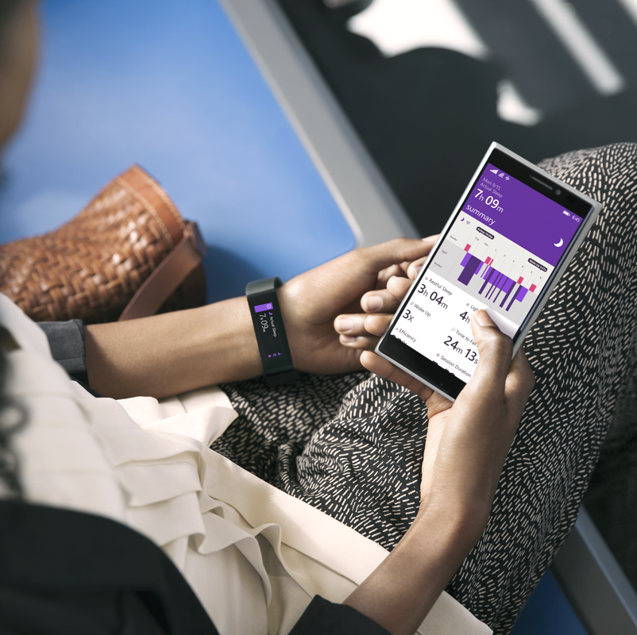
Some experiences are defined by hardware

Slide 32
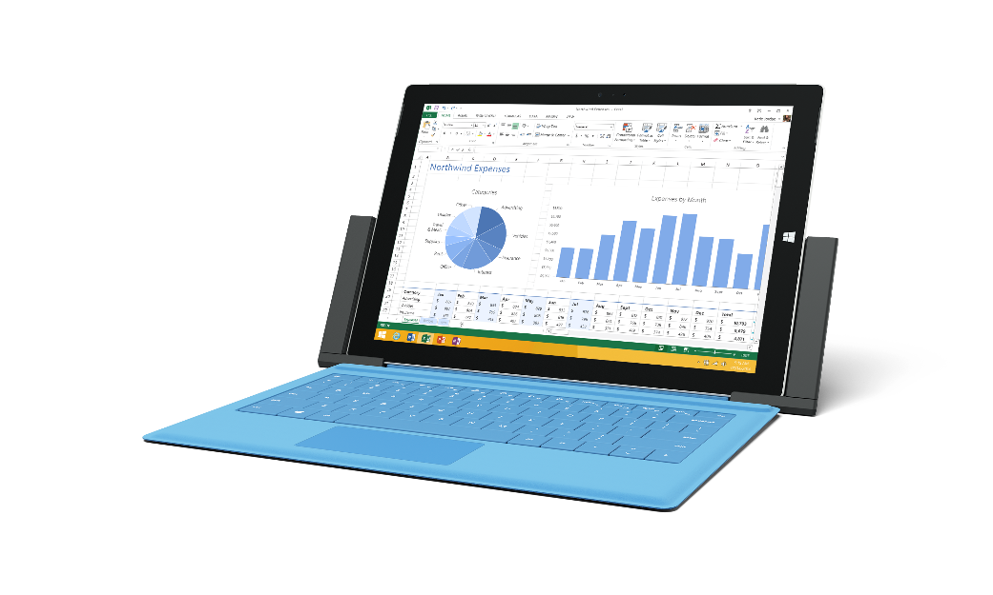
Peripherals can come and go at any time

Slide 33
Hardware preferences
Protect your customers and your app’s rating
Declare the hardware you need
Store will inform customers for you
Reviews only come from qualifying devices

Slide 34
Hardware preferences
Touch screen
Mouse
Keyboard
Camera
NFC HCE
NFC
Bluetooth LE
Telephony
All preferences work across consistently all Windows 10 device families
Store detects this hardware with public APIs

Slide 35
Participating in Business Store
Making your apps available to new customers
Apps are listed in the Business Store automatically
Opt-in to offline licensing for your app
Privately publish applications to specific businesses

Slide 36
Monetize & Promote Your App with Ads

Slide 37
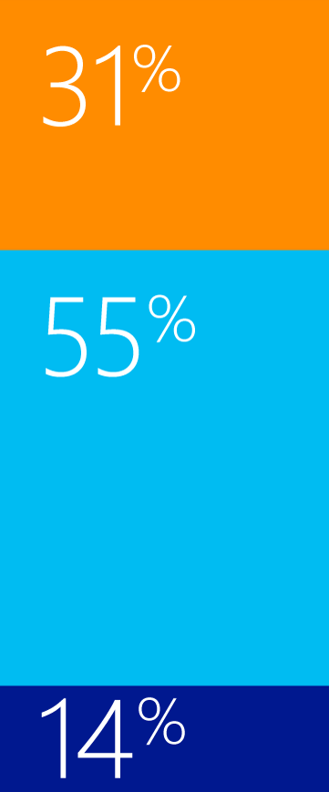
Advertising delivers tremendous value for app developers
Developer Revenue by Source
We are seeing consistent increase in year-over-year revenue.¹
“
FY14
FY15
Advertising
In-App Purchase
Paid Apps
Total Revenue
Sep
Oct
Nov
Dec
Jan
Feb
Mar
Worldwide, Microsoft Internal, Jan–Mar 2015
1. Worldwide, Microsoft Internal

Slide 38
Promote your app in 3 steps
select creative
set
targeting
measure
install

Slide 39

“Promote Your App” is better than ever!
Available now!
Promote your app from Dev Center
Auto-targeting
Age & gender targeting - at no extra cost!
1st Party App Install Tracking (beta)
Cross promote your apps for free!
Coming with Windows 10
BT & App Category based targeting
Promote your app in new markets
Windows 10 campaign attribution tracking
3rd party install tracking analytics & measurements
Flexible payment options
Use your Publisher Earnings
PayPal
Campaign budget increased to $10,000

Slide 40



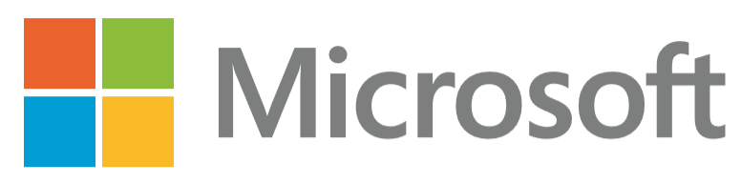




Windows ad mediation

